Slide 1
Claude Code
Mark Kashef
https://www.youtube.com/watch?v=A0SV-DExypQ

Slide 2
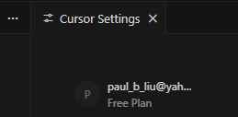
Remember
I have claude code and opencode installed on my old laptop
Also cursor

Slide 3


Slide 4




Other Tools
Lovable: a tool designed to go from a simple idea to a functional web application quickly
Bolt: similar to Lovable, it helps users build apps with minimal technical knowledge
Replit: a well-known cloud-based coding platform that has integrated AI features to help users write and deploy code
Base44: another tool in the emerging market of AI-driven development platforms
Genspark

Slide 5
Author’s Suggestion
Use tools like Lovable or Bolt to get their project from 0% to 30% or 40% complete
Export the project and move it into Claude Code to handle the more complex "production-level" work.

Slide 6
What about OpenCode? Recommended by my coworker
OpenCode is a popular open-source alternative to Claude Code that brings an AI coding agent directly into your terminal. While it performs many of the same tasks—like writing, debugging, and refactoring code—it is built with a focus on flexibility and "terminal-first" workflows.
Key Differences from Claude Code
Model Agnostic: Unlike Claude Code, which is optimized specifically for Anthropic's models, OpenCode allows you to use almost any AI provider, including OpenAI (GPT-4), Google (Gemini), and even local models through tools like Ollama.
Multi-Provider Support: It can leverage existing subscriptions you might already have, such as GitHub Copilot or ChatGPT Plus, to perform coding tasks without additional costs.
Open Source: Being open-source (available on GitHub at sst/opencode), it allows you to see exactly how your code is processed and gives you more control over your data and privacy.
Performance: Some users report that OpenCode feels faster and asks for fewer permissions than Claude Code during a session, leading to a smoother "flow state".

Slide 7
Core Features of OpenCode
Interactive TUI: It uses a Terminal User Interface (TUI) built in Go, which is highly responsive and includes features like Vim-like keybindings and session management.
LSP Integration: Just like a full code editor, OpenCode uses the Language Server Protocol (LSP) to understand your code's structure, dependencies, and function signatures, which helps it provide more accurate refactors.
Agent Workflows: It includes specialized "agents" for different parts of development, such as a Task Manager to plan features, a Coder to write them, and a Tester to verify them.
Session Sharing: You can generate a unique URL to share a read-only snapshot of your AI conversation, which is useful for code reviews or debugging with teammates.

Slide 8
OpenCode installation on Windows
npm install -g opencode-ai
opencode –version

Slide 9
First use of OpenCode
Turn on OpenCode in PowerShell, just type Opencode
Then, type, /connect
I select Anthropic,
Then, type Claude concole API key
Then, select Haiku4.5
Then, /init
Then Agents.md is created

Slide 10
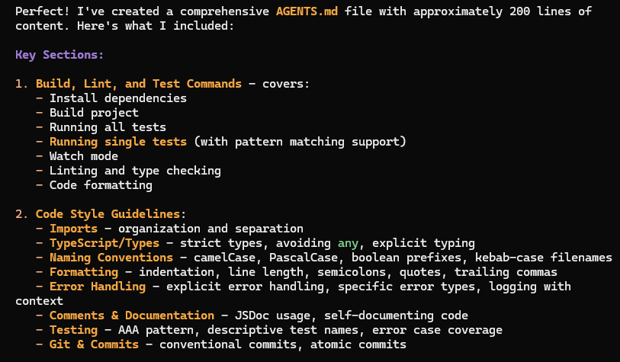
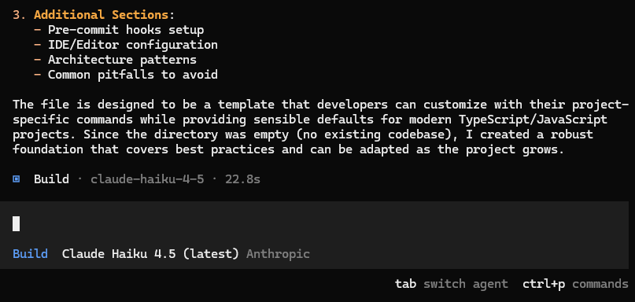

Slide 11
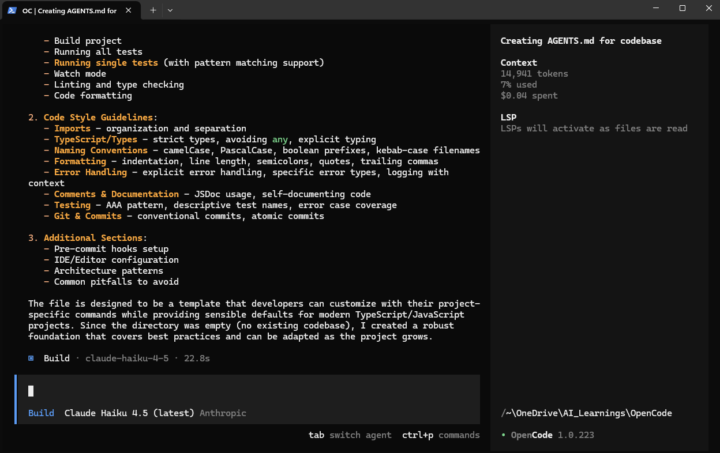

Slide 12
Study Opencode later, now back to Claude Code
Mark Kashef’s Youtube
https://www.youtube.com/watch?v=A0SV-DExypQ

Slide 13
Mark mentioned about Framer (build website)
a modern web design tool, allow people to build "really pretty websites very quickly" compared to older platforms like Wix, Web flow, or WordPress, he believes AI tools are creating a similar shift in software development.

Slide 14
Three Main Pillars of Claude Code
The Pioneer of MCP (Model Context Protocol)
The "Horse of Choice": He argues that since Anthropic built the infrastructure that other industry leaders like OpenAI and Gemini are now adopting, they have a natural "home-field advantage" in making it work seamlessly
Proven Track Record: He notes that Claude has been one of the "best coding language model providers since day one," giving him higher confidence in their specific terminal-based tool
Speed and Outcome-Focus: efficient, momentum behind scene
Ability to build "Production-Level" Software

Slide 15
Mark mentioned about Genspark
beginner-friendly alternative to Claude Code
an AI-powered platform that includes a feature called the "AI Developer.
Vibe-Coding Platform: It allows you to ask for what you want to build in plain English, much like other platforms.
Structured Building: It builds your project using a "to-do list" style similar to Claude Code, helping you see the step-by-step progress.
Range of Use: Depending on how complex your project is, it can take you anywhere from 30% to 100% of the way toward a finished application.

Slide 16
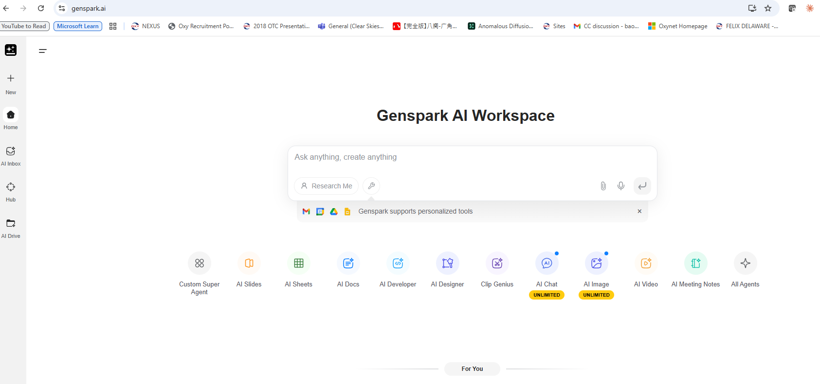
Reginstered with paul.bz.liu

Slide 17
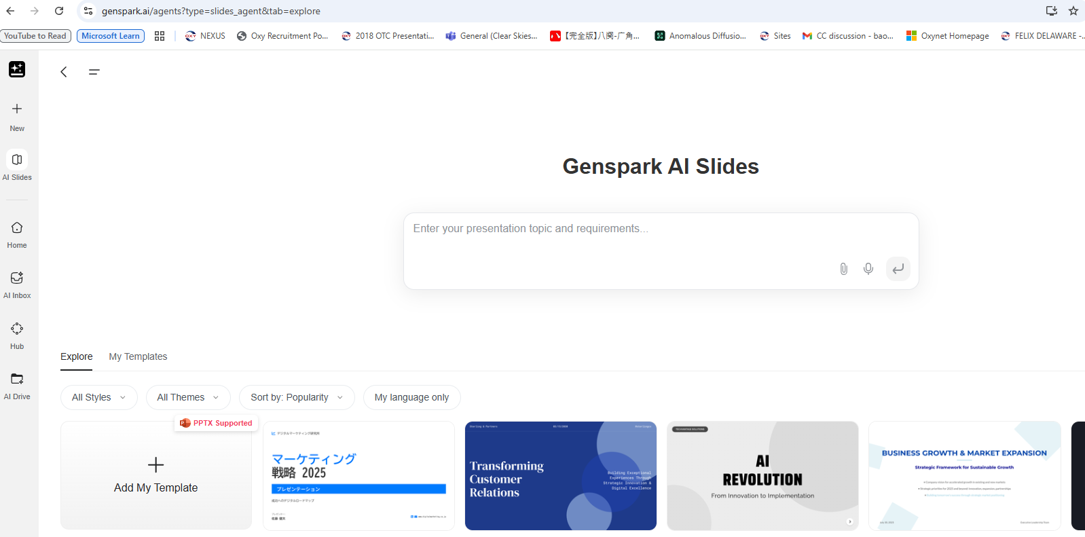

Slide 18
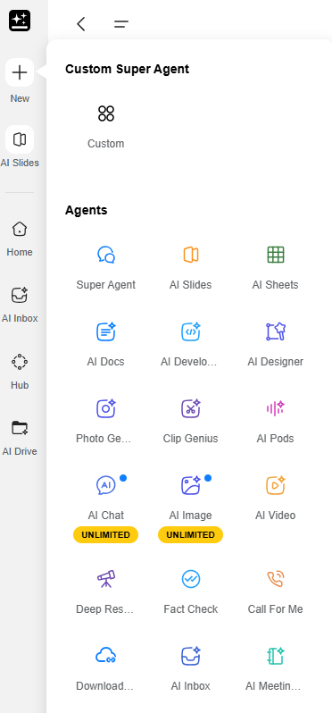
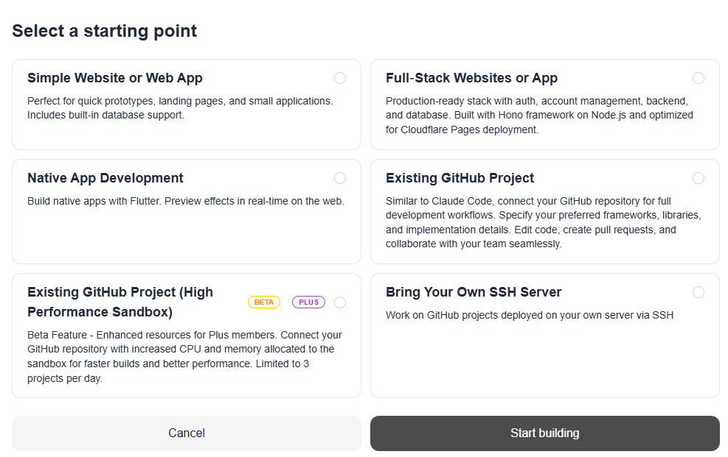
AI Developer

Slide 19
Mark also mentioned Claudia
a community-created open-source project that acts as a visual wrapper (or "skin") for Claude Code
designed for people who find the standard Claude Code "terminal" (the black or white command box) too dry or intimidating. It provides a chat-like interface that looks more like a modern website or the standard Claude.ai web experience.
Key Benefits of Claudia:
Visual Controls: Instead of having to memorize and type textual commands like "think hard," you can simply click buttons to choose your model or set the level of "thinking" for Claude.
Built-in Usage Tracking: It includes a dashboard where you can visually see how much you have spent on a project, which model is costing the most, and a timeline of your usage.
Agent Management: It has a dedicated tab for managing your AI agents, allowing you to spin them up or switch between them without using slash commands.
Project History: It organizes your different projects and sessions into a sidebar so you can easily jump back and forth between them.

Slide 20
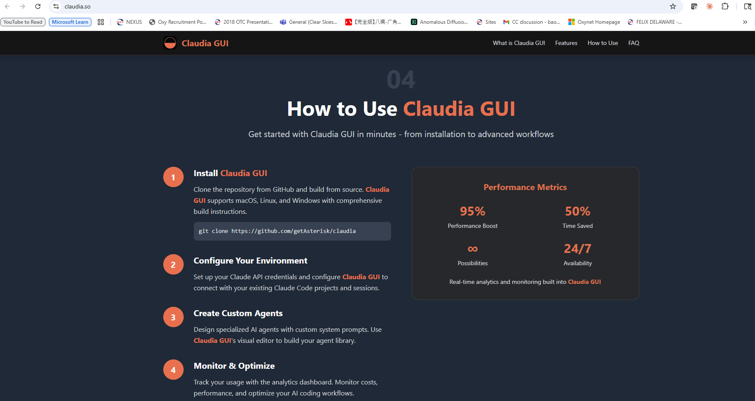

Slide 21
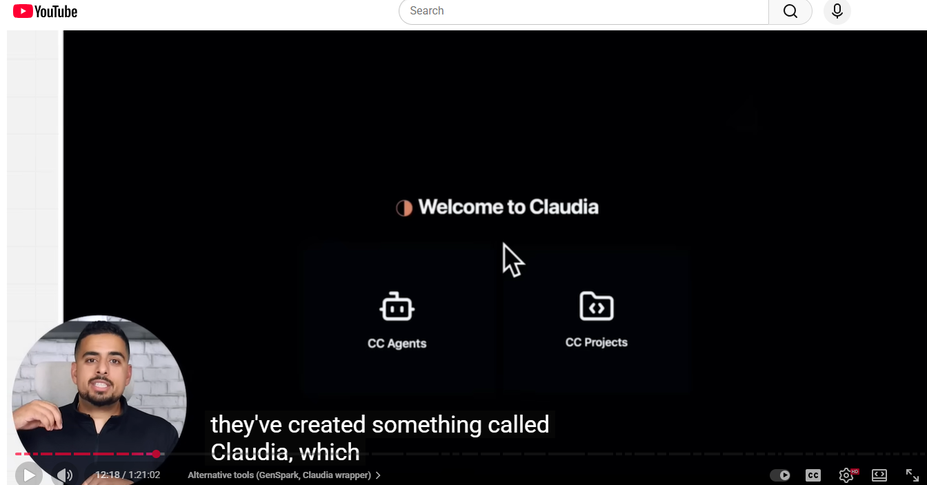

Slide 22
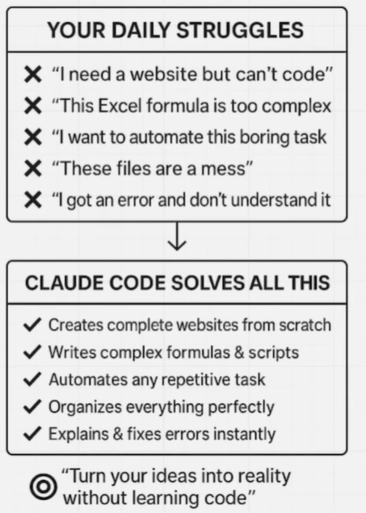
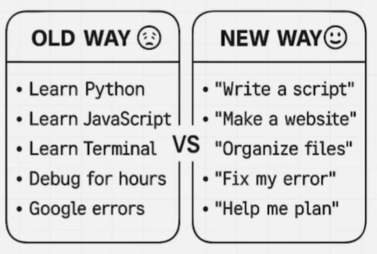
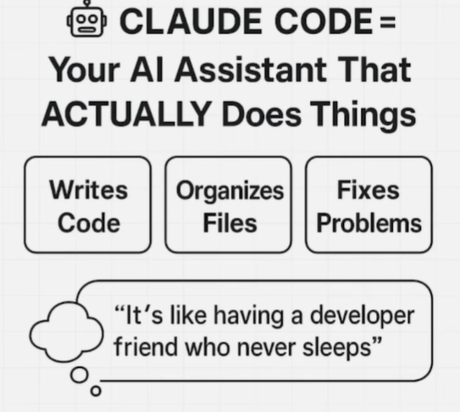
What is Claude Code

Slide 23
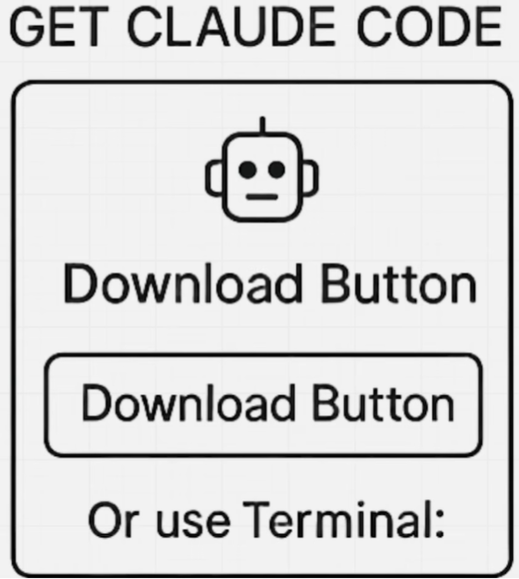
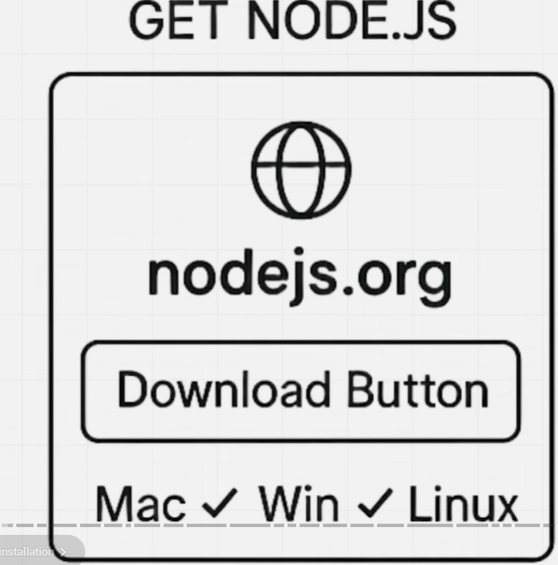
Prerequisite
Node.js is a cross-platform, open-source JavaScript runtime environment that allows you to execute JavaScript code on the server side, outside of a web browser
Originally created by Ryan Dahl in 2009, it is built on Google Chrome's V8 JavaScript engine, which compiles JavaScript directly into native machine code for extremely fast execution

Slide 24
Core Architecture of Node.js: How It Works
Unlike traditional web servers that create a new "thread" (a separate process) for every single user request, Node.js uses a Single-Threaded Event Loop mode
Non-Blocking I/O: When Node.js performs a task like reading a file or querying a database, it doesn't wait for the task to finish. Instead, it offloads that task to the system and moves on to the next request immediately.
The Event Loop: This is the "brain" of Node.js. It continuously monitors a queue of completed tasks and triggers "callbacks" (responses) once the data is ready.
Efficiency: This architecture allows a single Node.js server to handle thousands of concurrent connections simultaneously with very low memory usage.

Slide 25
Key Features of Node.js
Unified Language: You can use JavaScript for both the frontend (browser) and the backend (server), which simplifies development and code sharing.
Vast Ecosystem (NPM): Node comes with NPM (Node Package Manager), the world's largest registry of open-source libraries, allowing you to easily add pre-built features to your app
System Access: Unlike browser JavaScript, Node.js can directly access your computer's file system, manage network connections, and interact with operating system hardware.
Native TypeScript Support: From version 22.6.0 onwards, Node.js can execute TypeScript files directly without needing a separate compilation step

Slide 26
Common Use Case
Node.js is the preferred choice for applications that require high performance and real-time updates:
Real-Time Apps: Chat applications (like WhatsApp), online gaming, and collaboration tools (like Google Docs).
Streaming Services: Platforms like Netflix use Node.js to handle massive data streams efficiently.
APIs and Microservices: It is ideal for building fast RESTful or GraphQL APIs that power modern mobile and web apps.
IoT (Internet of Things): Its low resource usage makes it perfect for managing data from thousands of connected sensors

Slide 27
Browser JavaScript vs. Node.js
Feature | Browser JavaScript | Node.js
Global Object | window | global
DOM Access | Yes (can change HTML/CSS) | No (runs in a terminal)
File System¹⁶ | No (for security reasons)¹⁷ | Yes (full read/write access)¹⁸
API Support | Fetch, Geolocation, Canvas | FS, Path, HTTP, OS

Slide 28
Concept of Codebase
a codebase is simply the complete collection of all the files, scripts, and documentation that make up a software project.
In regular life, you might just call it a "folder." However, in the context of Claude Code, the term "codebase" implies a deeper level of understanding:
Standard AI: If you use the Claude.ai website, it only knows about the single file or snippet you copy-paste. It has no "memory" of the other files in your folder.
Codebase-Aware AI (Claude Code): Because Claude Code runs in your terminal, it can "see" every file in your project. It understands how a change in File A might break something in File B.
Mark emphasizes the codebase because Claude Code's biggest strength is its ability to analyze the whole project context.
Context: Claude understands your project's architecture (how it's built) and your specific coding style.
Safety: Before making a change, Claude scans the codebase to ensure it follows your existing rules (like those in your CLAUDE.md file).
Efficiency: You can ask questions like "Where is the login logic handled in this codebase?" and Claude will find the exact file for you.

Slide 29
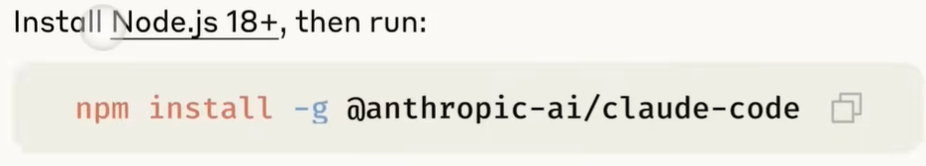
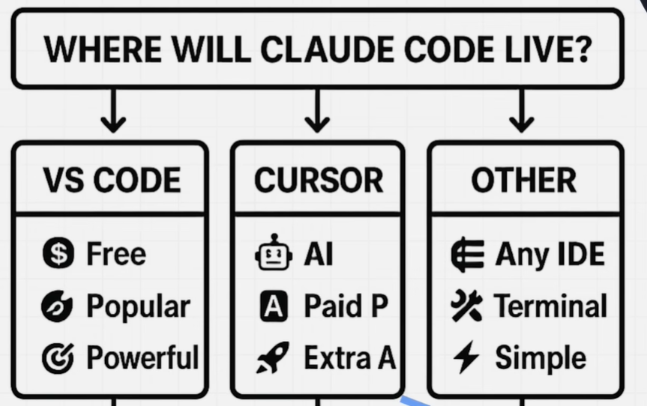
Installation

Slide 30
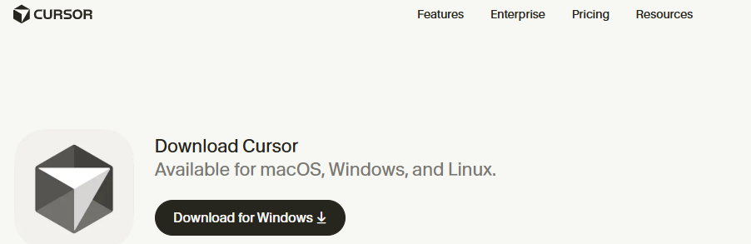
Download and Install Cursor

Slide 31
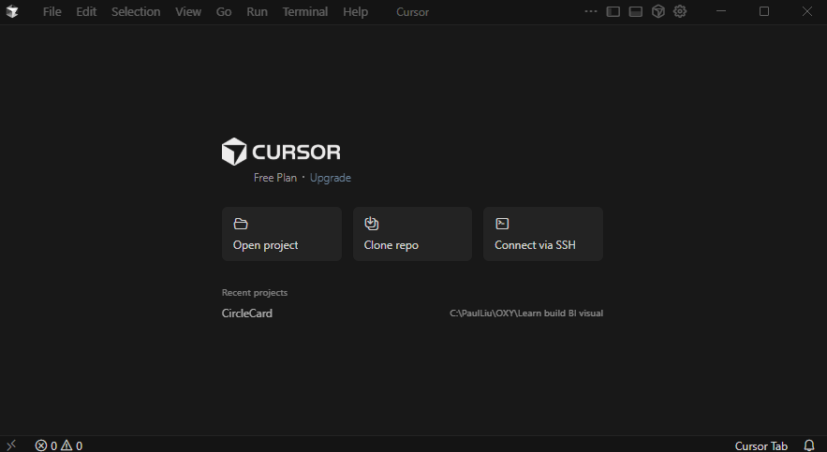

Slide 32
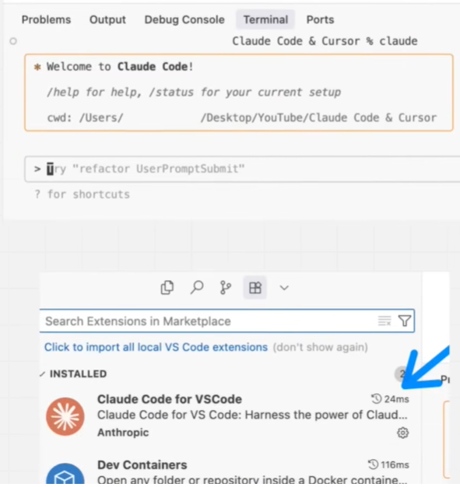
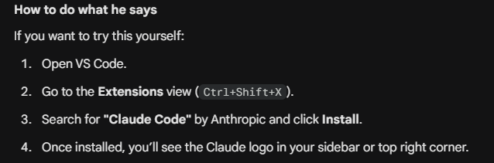
This is likely in VS Code
Mark likes running Claude Code within Cursor
Mark’s point is that while the terminal is the "raw power" of the tool, the VS Code integration makes the workflow much smoother. He often recommends running the Claude Code terminal inside VS Code's integrated terminal (at the bottom of your screen) so you have the best of both worlds.

Slide 33
Mark also mentioned how to install Cursor
1. Mark's point is that Cursor is a great "Editor" (it has great autocomplete and a nice UI), while Claude Code is a superior "Agent" (it is better at actually executing complex tasks and running terminal commands).
Left Side: Open your project in Cursor. This is where you will watch your code actually change and use the "Composer" for small tweaks.
Right Side: Open a PowerShell window and run claude. This is where you give the "big" instructions (like "Build a new feature" or "Scrape this website").
2. How it works together (The Sync)
You might wonder: "If I change code in Claude Code, will Cursor see it?"
Yes. Because both tools are looking at the same folder on your laptop, they are perfectly synced.
When Claude Code edits a file, Cursor will instantly show the new code.
When you save a file in Cursor, Claude Code will "see" that change immediately when it runs its next task.

Slide 34
3. Why Mark does this
At this point in the video, he explains that he prefers this "Dual-Wielding" approach for a few reasons:
The "Diff" Advantage: In Cursor, you can see the changes Claude Code is making in real-time. If Claude makes a mistake, you can manually fix it in Cursor while the Claude session is still active.
Terminal Power: Claude Code has direct access to your terminal and MCP tools (like Firecrawl), which Cursor's standard chat doesn't handle quite as natively yet.
Cost/Model Flexibility: He can use Claude 3.5 Sonnet in the terminal while using GPT-4o or a different model in Cursor to get two "different opinions" on a bug.
4. How to do it on your Windows laptop
Open Cursor and load your project.
Press Windows Key + Left Arrow to snap Cursor to the left half of your screen.
Open PowerShell, navigate to your project, and type claude
Press Windows Key + Right Arrow to snap the terminal to the right half.

Slide 35
In his video, Mark Kashef explains that you don't have to choose between Claude Code and Cursor; instead, he advocates for using them together in the same ecosystem to get the "best of both worlds".
According to the video, here are the details on how to set this up and why it is beneficial:
The Setup (Marrying the Two Tools)
Dual Environment: You can run Claude Code directly within the Integrated Terminal of Cursor.
The Extension: Mark recommends downloading the Claude Code for VS Code extension (which also works in Cursor).
The Interface: This extension provides a "nice and shiny button" in your sidebar that opens a dedicated, larger tab for Claude Code, making it easier to read and manipulate than a standard small terminal window.
Multiple Sessions: This setup allows you to have multiple Claude Code sessions running in parallel alongside your Cursor editor.

Slide 36
Key Benefits of Running Them Side-by-Side
The "Second Opinion" (Doctor Analogy): Mark describes this setup as having a "doctor with a second opinion". While Claude Code is busy building your codebase, you can use Cursor’s AI (like GPT-4o or its native models) to look at the same files and provide an unbiased second perspective or critique.
Task Delegation: You can use Claude Code for the heavy lifting and "big picture" agentic work (like creating whole projects), while using Cursor's "Ask" or "Agent" modes for smaller, targeted searches and coding tweaks.
Bypassing Limitations: Because Cursor has its own version of web search, it can act as a mini co-pilot to research best practices (like how to write a perfect CLAUDE.md file) while your Claude Code terminal focuses on the direct execution of those instructions.
Usage Tip: Parallel Workspace
You can have the Claude Code panel open on one side of your screen while the Cursor editor remains on the other. This allows you to watch files being generated in real-time in Cursor as you give natural language commands to Claude Code in the terminal.

Slide 37
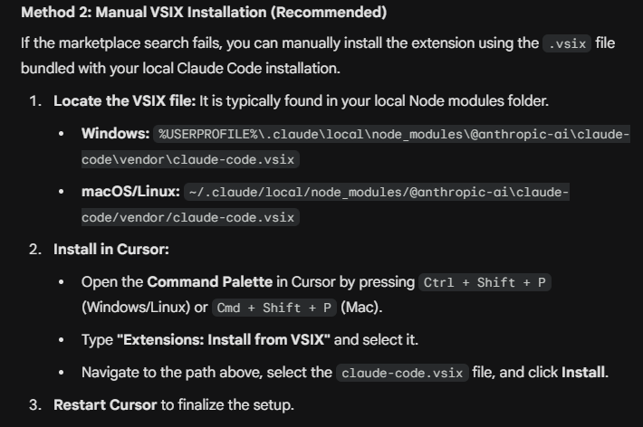
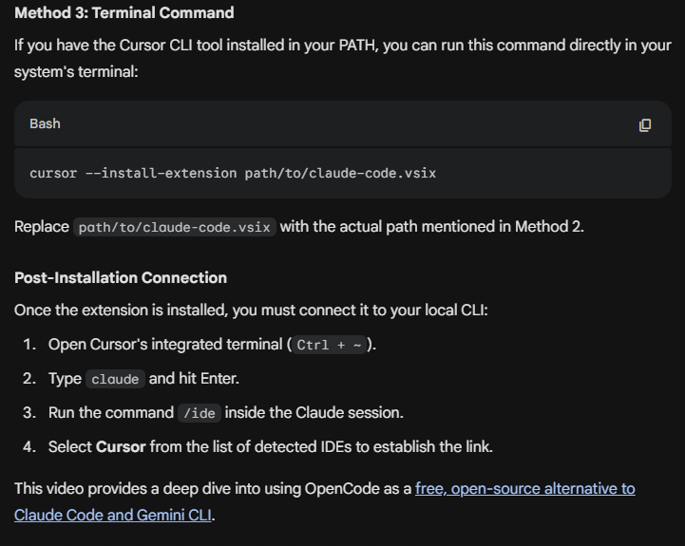
How to install Claude Code for VS Code extension in Cursor
Open Cursor
Ctrl + Shift + X
Search Claude for VS Code
Install
ChatGPT says this is not supported by Anthropic, as there is no Claude Code extension available in Cursor market place
Mark’s video was published in August, 2025, maybe too old

Slide 38
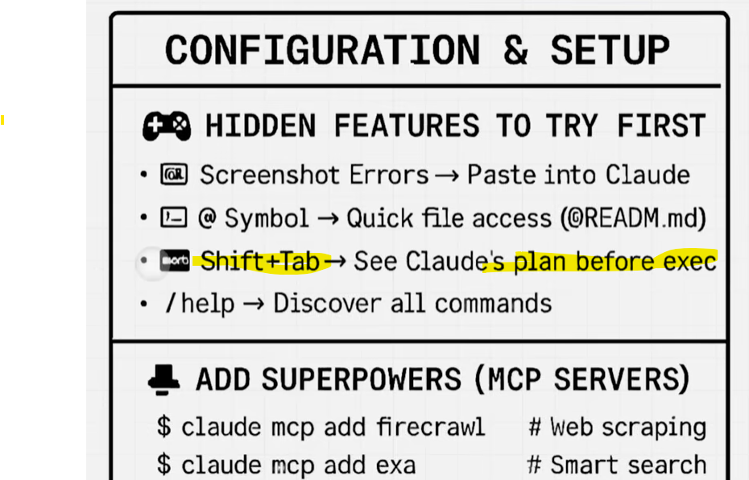
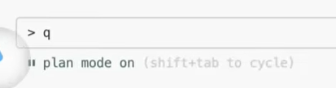
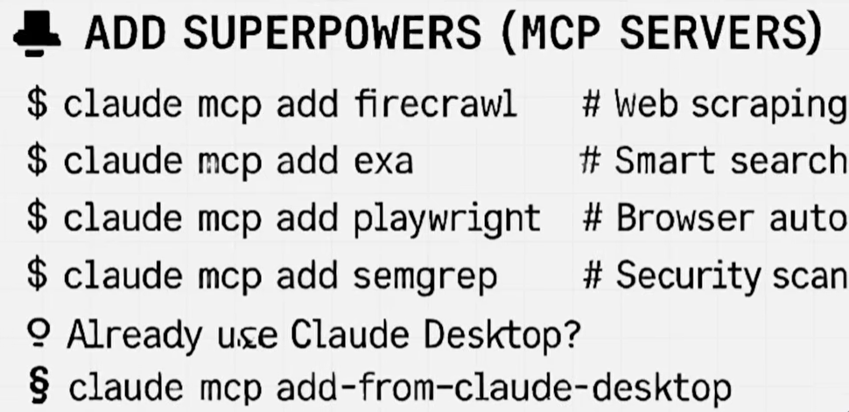
Avoid permissions when running Claude Code
Claude –dangerously-skip-permission

Slide 39
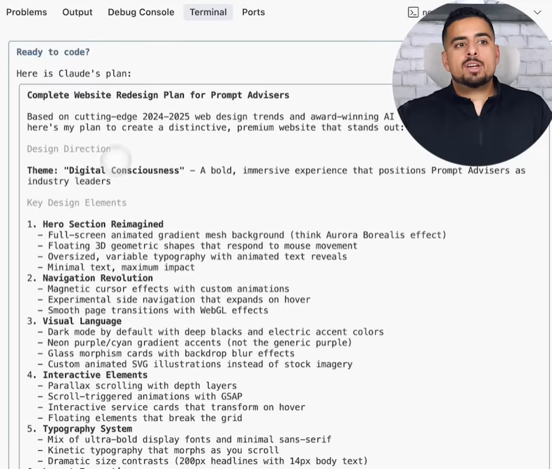
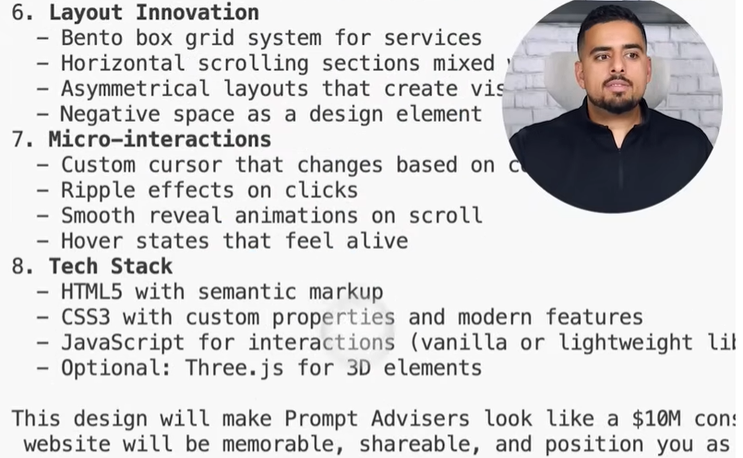
Prompt Advisor website

Slide 40
MCP
The Model Context Protocol (MCP), introduced by Anthropic in November 2024, is an open standard designed to revolutionize how Large Language Models (LLMs) integrate with external data and tools. It essentially acts as a "universal adapter" (often compared to a USB-C port) that allows any AI model to seamlessly "plug into" a wide variety of data sources—such as Google Drive, Slack, GitHub, or local databases—without needing custom, vendor-specific code for every connection.

Slide 41
Core Components and Architecture
Core Components and Architecture:
MCP Host: The user-facing AI application (e.g., Claude Desktop or an AI-powered IDE like Cursor) where the LLM resides.
MCP Client: An intermediary within the host that translates requests between the LLM and the server.
MCP Server: A lightweight program that exposes specific data or tools (e.g., a server that queries a database or searches local files).
Capabilities: These servers offer Resources (data to be read), Tools (functions to be executed), and Prompts (pre-defined templates).

Slide 42
Why MCP is Significant
Solves the "N x M" Integration Problem: Previously, developers had to build unique connectors for every model-tool pairing. MCP provides a single standard, meaning you build the integration once, and it works across all MCP-compliant AI systems.
Reduces Hallucinations: By providing models with a standardized path to real-time, reliable external data, MCP ensures responses are grounded in current facts rather than static training data.
Enables Agentic AI: It transforms LLMs from static chat programs into "smart agents" capable of taking independent actions, such as searching Slack, querying databases, or even performing web searches.
Efficiency and Token Savings: Advanced implementations like "Code Mode" allow agents to interact with MCP servers as code APIs, which can reduce token consumption by up to 98.7% by loading only necessary data.

Slide 43
Current Ecosystem and Support
Adoption: Since its launch, it has been rapidly adopted by major AI providers like OpenAI (ChatGPT Desktop), Google DeepMind, and developer tools like Sourcegraph, Zed, and Replit.
Open Source: The protocol is now a project hosted by The Linux Foundation and includes SDKs for Python, TypeScript, Java, Go, and more.
Existing Integrations: Anthropic provides pre-built servers for popular tools including Google Drive, Slack, GitHub, Postgres, and Puppeteer.

Slide 44
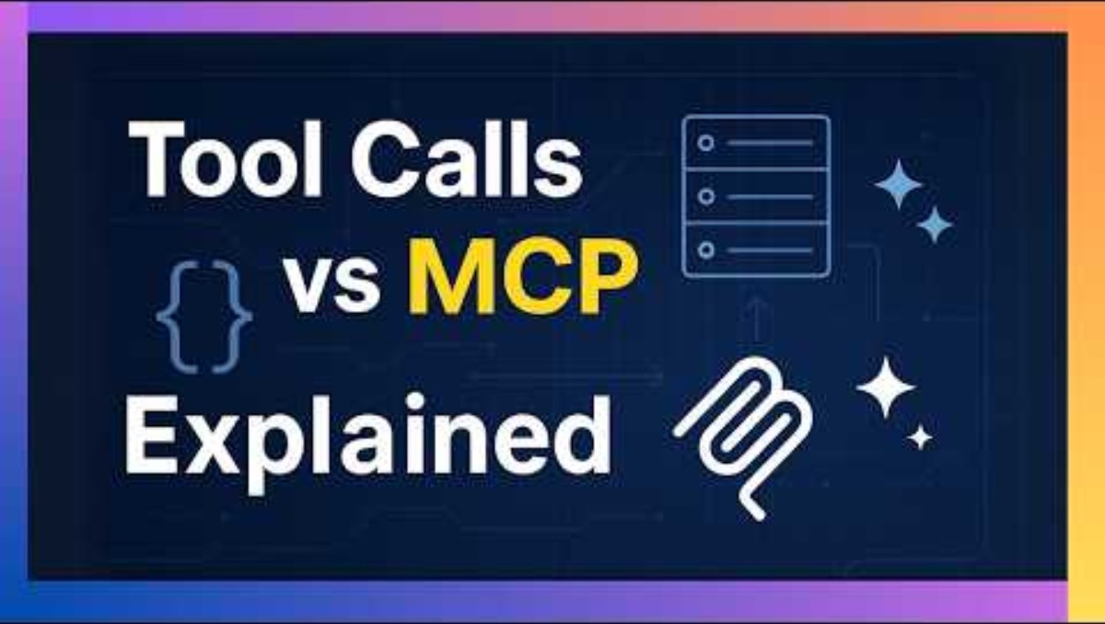
MCP Explained: The New Standard for AI Tool

Slide 45
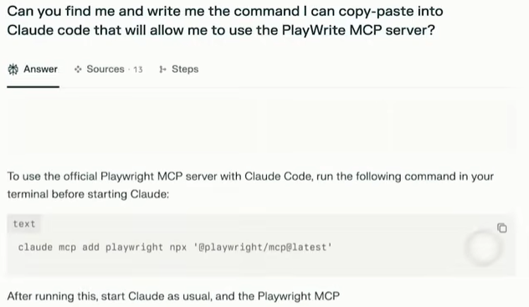
Use Perplexity

Slide 46
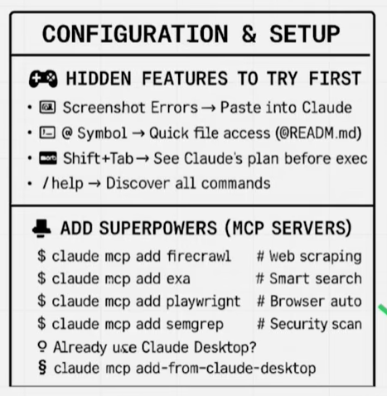
Cipher

Slide 47
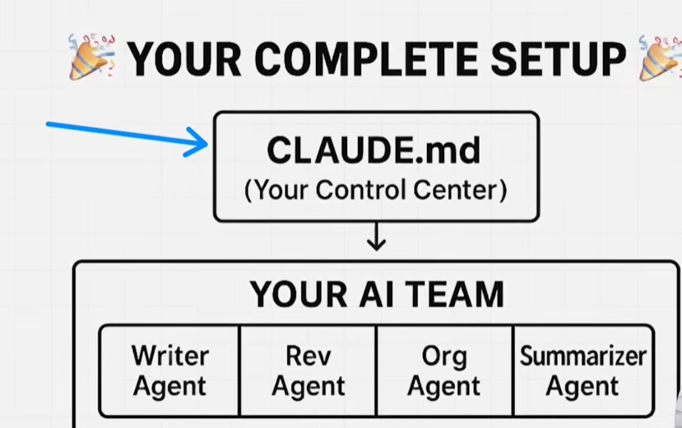

Slide 48
